Slide 1
Module 7
Pipes

Slide 2
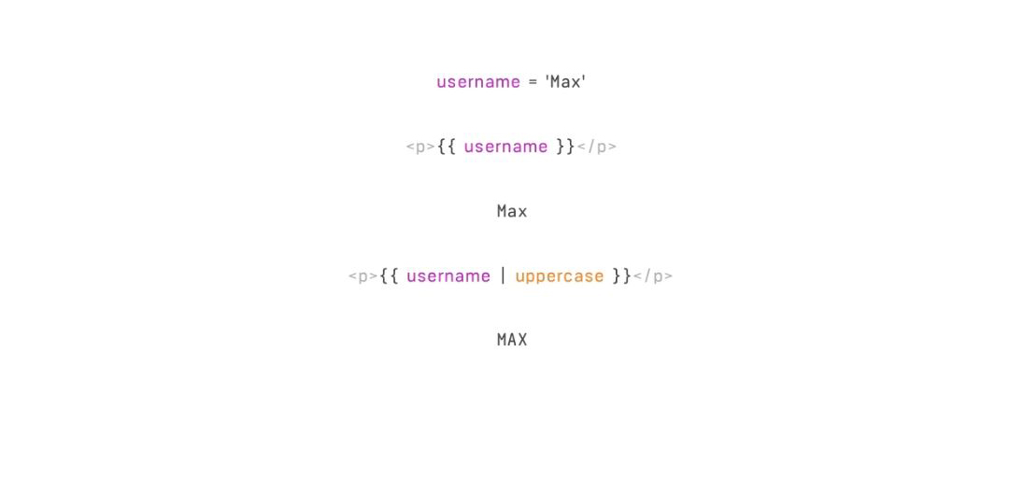
What are pipes
They are a simple way to transform values in an Angular template

Slide 3
Built-in pipes
Angular comes with a stock of pipes such as DatePipe, UpperCasePipe, LowerCasePipe, CurrencyPipe, and PercentPipe. They are all available for use in any template.

Slide 4
Parameterizing Pipes
A pipe can accept any number of optional parameters to fine-tune its output
<p>The hero's birthday is {{ birthday | date:"MM/dd/yy" }} </p>

Slide 5
Chaining Pipes
You can chain pipes together in potentially useful combinations
{{ birthday | date | uppercase}}

Slide 6
Custom Pipes
@Pipe({name: 'exponentialStrength'})
export class ExponentialStrengthPipe implements PipeTransform {
transform(value: number, exponent: string): number {
let exp = parseFloat(exponent);
return Math.pow(value, isNaN(exp) ? 1 : exp);
}
}

Slide 7
Pure and Impure Pipes
A pure pipe is only called when Angular detects a change in the value or the parameters passed to a pipe
An impure pipe is called for every change detection cycle no matter whether the value or parameters changes. This is relevant for changes that are not detected by Angular
@Pipe({name: 'exponentialStrength‘, pure: false})

Slide 8
Async Pipes
The AsyncPipe accepts a Promise or Observable as input and subscribes to the input automatically, eventually returning the emitted values.
The AsyncPipe is also stateful. The pipe maintains a subscription to the input Observable and keeps delivering values from that Observable as they arrive.
{{messages | async}}

